Slide 1
FAKE NEWS DETECTION
By : Preetha

Slide 2

OBJECTIVE To detect fake news from different data sources and to differentiate between “Real” news and “Fake” news.
FAKE NEWS DETECTION

Slide 3
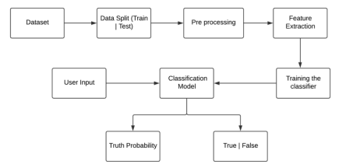
FAKE NEWS DETECTION
METHODOLOGY
Cleaned the data
Pre processing
Fit the model
Detection

Slide 4
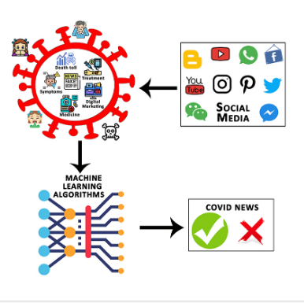
KEY FINDINGS
TFIDF Vectorizer
Accuracy – 98%
To Detect the Fake News

Slide 5
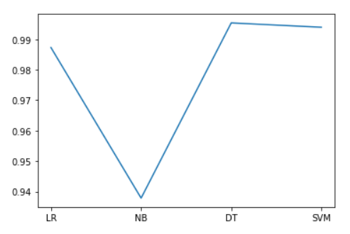

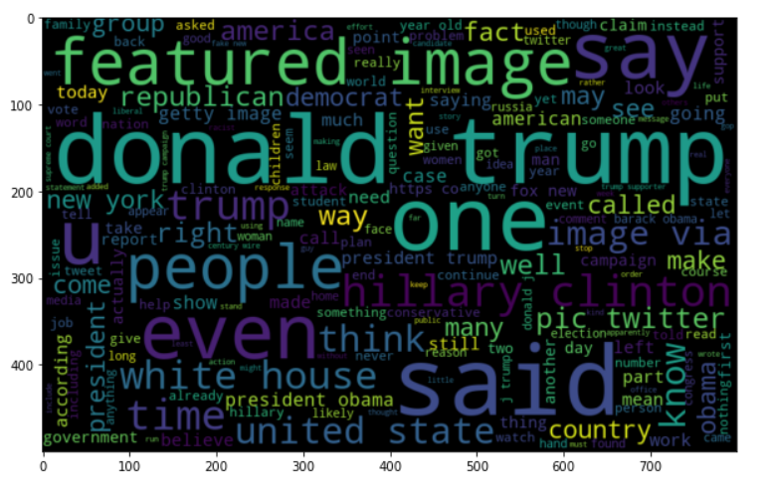
FAKE NEWS DETECTION
CONCLUSION
This project successfully distinguishes between a true and fake news by using multiple classifiers by calculating their accuracy.

Slide 6
REFERENCE
Dataset from Kaggle
Reference code : https://medium.com/swlh/fake-news-detection-using-machine-learning-69ff9050351f

Slide 7


